Slide 1
STATE MANAGEMENT

Slide 2
BACKGROUND
State management is a way to maintain information throughout the pages of an app.
When an app navigates between pages, information is often reset. One way to retain data is by saving and getting information from the database, but this method can be tedious to do on every navigation.
A state can be used to retain the user credentials, so that the user maintains access throughout the app, or store datasets that need to be repeatedly retrieved.
To maintain state, Vue uses vuex, React uses redux, and Web Forms use the Session object.

Slide 3
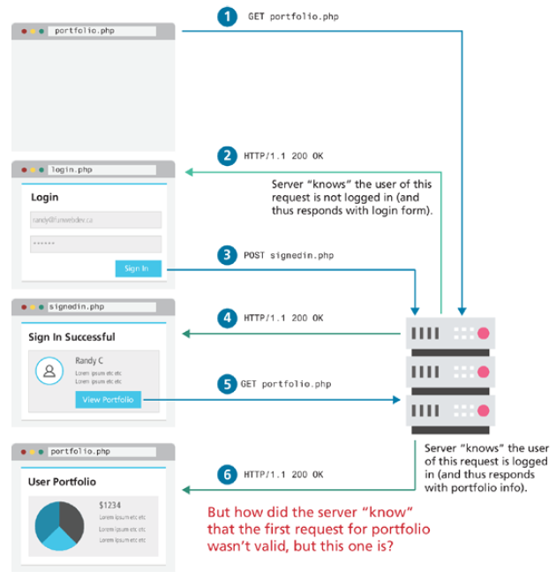
STATE MANAGEMENT

Slide 4
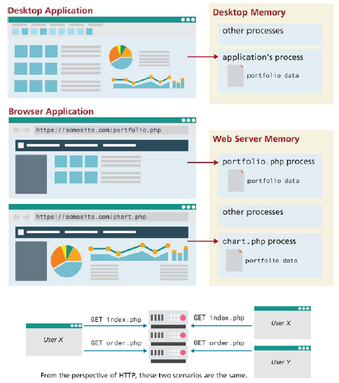
PASSING DATA
Unlike a desktop app, web apps does use desktop memory to hold information, they have to rely on HTTP requests, where each is essentially a request to run a separate program.
In web apps, the 3 methods of passing data are the following:
URL (server)
HTTP header (server)
Cookies (client)

Slide 5
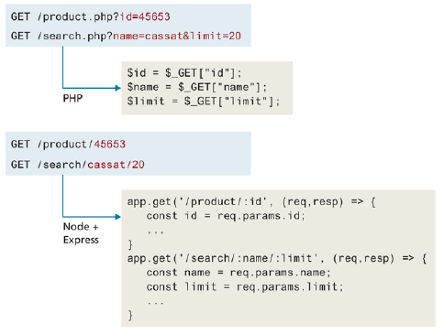
PASSING VIA URL
One way to pass data between pages is by using the GET method and using a query string with the id of the user.
Then this id can be fetched in the new page and check to see if the account still has access.

Slide 6
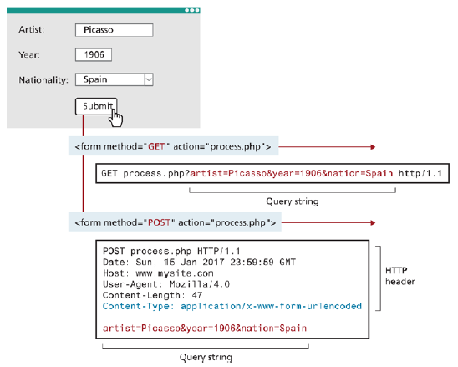
PASSING VIA HEADER
Another way to pass data is by using the POST method as part of the header data.
The data can be in JSON format.

Slide 7
COOKIES
Cookies are a client-side approach for persisting state information.
They are key-value pairs that are saved within one or more text files that are managed by the browser.
While cookies can be used to maintain state, they are not really used for that purpose. They are mainly used for storing the history of the user within a browser, such as login credentials and parameters they commonly enter within the app.
Cookies are commonly tracked by companies to review site activity.
In JavaScript, cookies can be stored using the document.cookie object.

Slide 8
COOKIES
It’s important that cookies do not contain the password of the user. It’s best to just contain the username, and an access token granted from the database.
A lesser efficient alternative would be to check authentication on every page load per the provided username.
Cookies containing sensitive information should have a short lifetime.

Slide 9
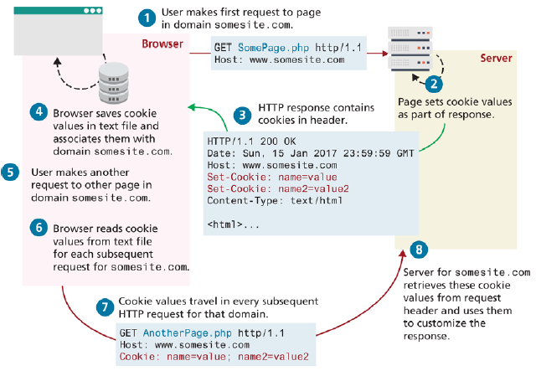
COOKIES

Slide 10
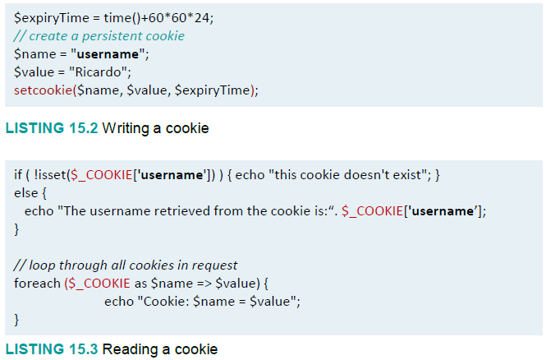
COOKIES IN PHP
Cookies in PHP are created using the setcookie() function and retrieved using the $_COOKIES superglobal array.
Cookies must be written before any other page output.

Slide 11
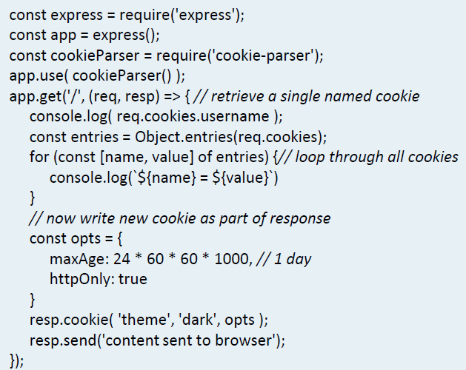
COOKIES IN NODE/EXPRESS
Cookie support in Node and Express needs to be installed with npm install cookie-parser.
Cookies can be read, written, and stored using JSON data.

Slide 12
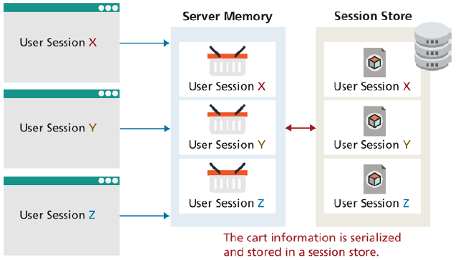
SESSION STATE
A session state is a server-based mechanism to store different states of multiple users.
Session states are dependent on session stores, a type of storage area for session information.

Slide 13
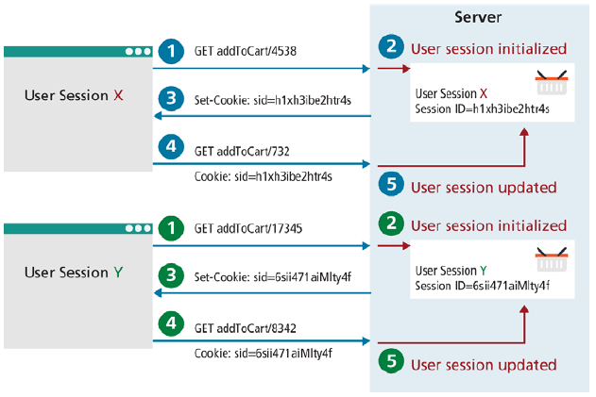
SESSION STORAGE
Since HTTP is stateless, an SID is required, or a unique session state identity.
This SID is transmitted back and forth between the user and server via a session cookie.
Sessions are kept in serialized files.
One downside to storing sessions is performance degradation, as opposed to storing them in localized cookies or memory addresses.

Slide 14
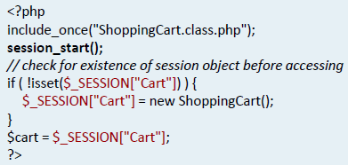
SESSION STATE IN PHP
In PHP, sessions can be accessed using $_SESSION, but you have to first call session_start().
If the session doesn’t exist, it might generate an error, and you will be redirected to the default page.

Slide 15
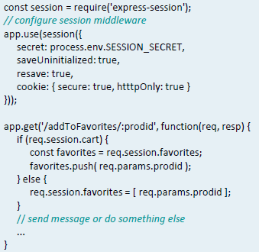
SESSION STATE IN NODE
In Node, sessions are maintained using Express i.e. express-session and cookie-session.
The express-session package supports different session stores, whether they be memory, files, external caches, or database.

Slide 16
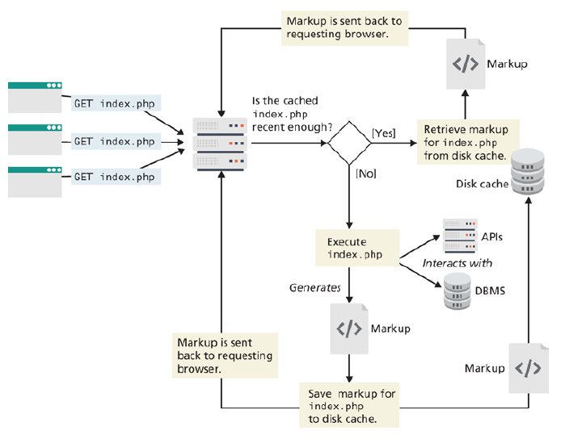
CACHING
Caching is a way to retain already fetched information in order to speed up the user experience.
Every time a page is requested, it must be fetched, parsed, and executed, which can be taxing for high traffic applications.

Slide 17
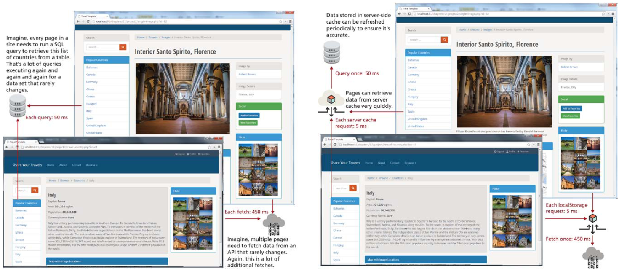
CACHING

